Slide 1
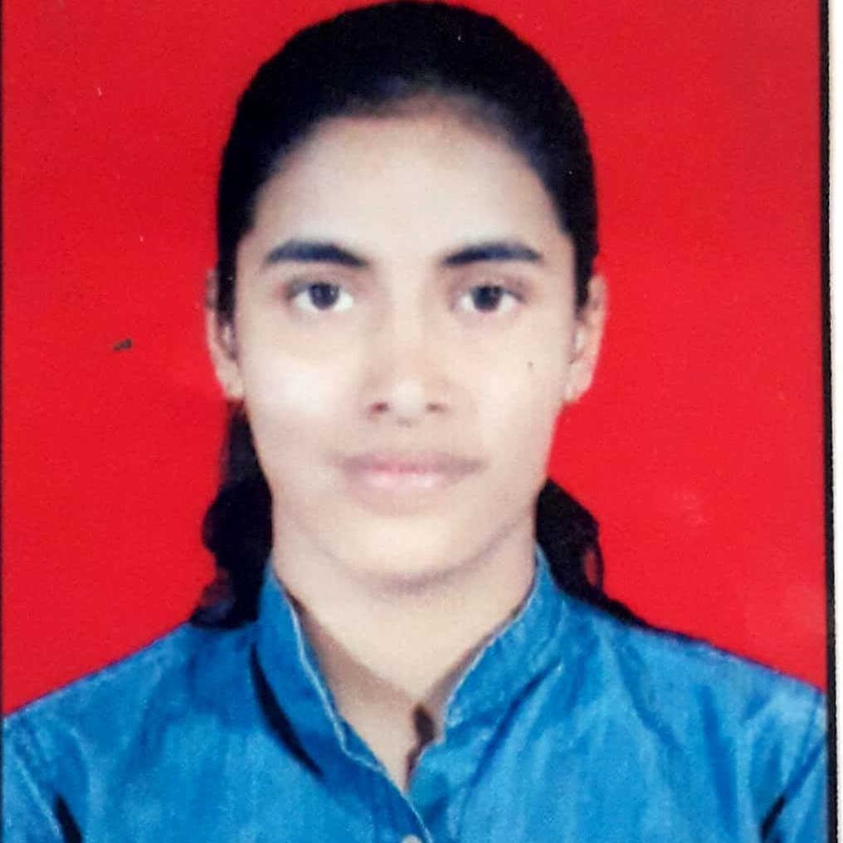
Education & Employment
backend, and database using Angular and java.
• Implemented RESTful APIs for seamless data integration between front-end and back-end
• Worked closely with the application on testing and debugging, ensuring high-quality deliverables. Optimized application performance.
• Utilized MySQL Workbench to enhance data retrieval efficiency and application performance.
• Conducted thorough unit testing to ensure application reliability, successfully deploying updates with minimal user disruption.
• Ensured robust MYSQL database connectivity, implemented Exception handling, and conducted comprehensive JUnit testing.
Ongoing | Capgemini
2022 | Bachelor of Engineering in Computer
2018 | HSC
Rutuja Kakad
Senior Analyst– A5
Trainings & Certification
Microsoft AZ – 900 Certified
Cumulocity IOT Basic - Certified
Mendix Rapid Developer – Certified
Attended "Basics of IOT" Workshop in college
Completed Capgemini training on Full Stack Web Development
"Programming in C" - Coursera
Key Competences
Technical competences: Java, Spring Boot,C , C++ , Data Structures , Basics of Core Java , HTML , CSS , Angular
Tools: VS Code , IntelliJ IDEA, Eclipse
Functional competences: Quick Learner , Interested to learn new skills , Problem Solving , Adaptability , Time Management
Projects
Title: Smart I :Application for visually Impaired People
Role & Responsibility:
Worked on front end and programming part , UML diagrams and also made PPT's ,and applied for paper publication .
Title: Covid Vaccination Management System
Role & Responsibility:
Worked on basic angular functionalities with HTML and CSS
Experience
Vodafone EOM
• Developed and maintained full stack application, enhancing functionality by adding new fields and features across the frontend,

